Slide 1
A brief presentation of my works
Computer Engineer
Richard Chan
Faculty Advisor: Allan Weber
chanrich@usc.edu

Slide 2
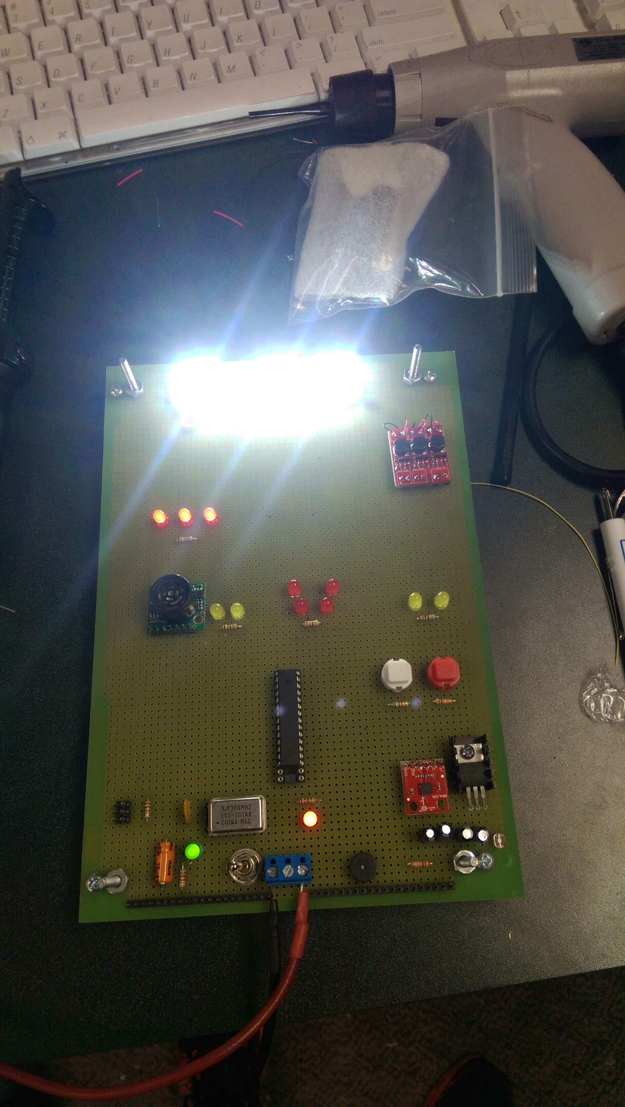
Smart Light – Embedded System
Smart safety-gadget for bike riders
Features:
Auto Lighting
Auto brake light
Turn signals
Rear incoming object detection
Components:
Atmega328P microcontroller
Ultrasonic sensor
Accelerometer
Light sensor
Speaker
LEDs, SMD LEDs
Notes:
Smart light is my senior capstone project. It is a smart lighting system for bikers to ride their bike at night
I came up with this idea because I rode my bikes to school and I often stay in the lab until very late.
It will be dark outside when I finished with my work and there are streets, alleys near in USC that are not illuminated very well.
I thought why can’t I create something cool that will help people to safely ride their bike home.
Smart light was completed last year and its functionalities includes auto lighting, auto brake light, turn signals, rear incoming object detection
The components I used in this project is listed here and I will talk about how I achieve each feature.

Slide 3
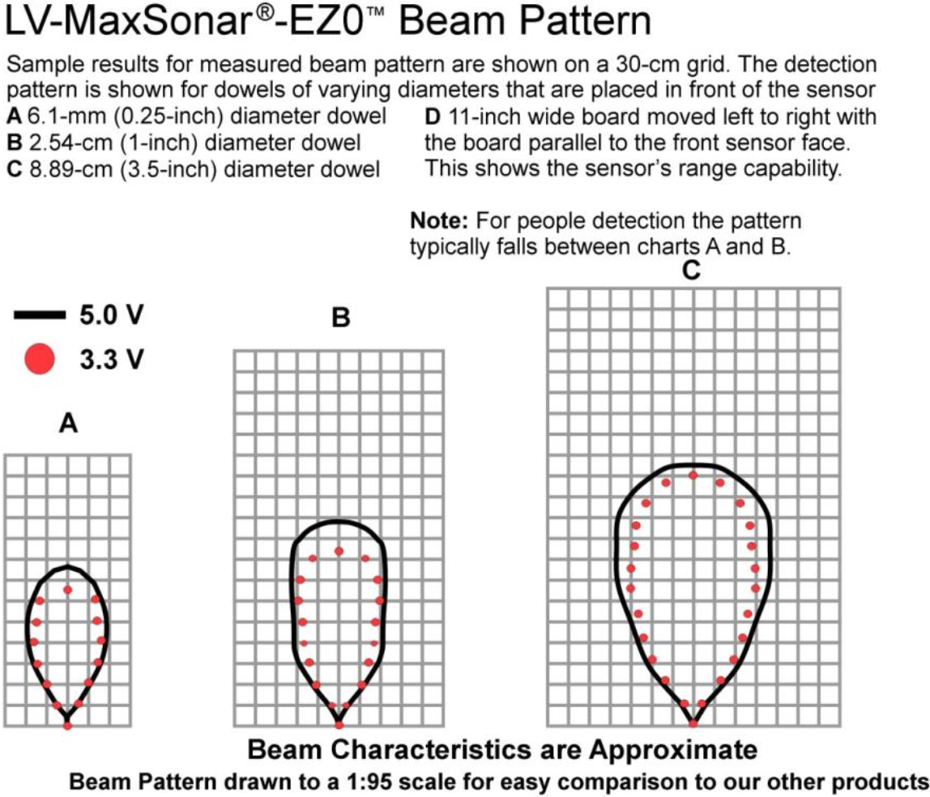
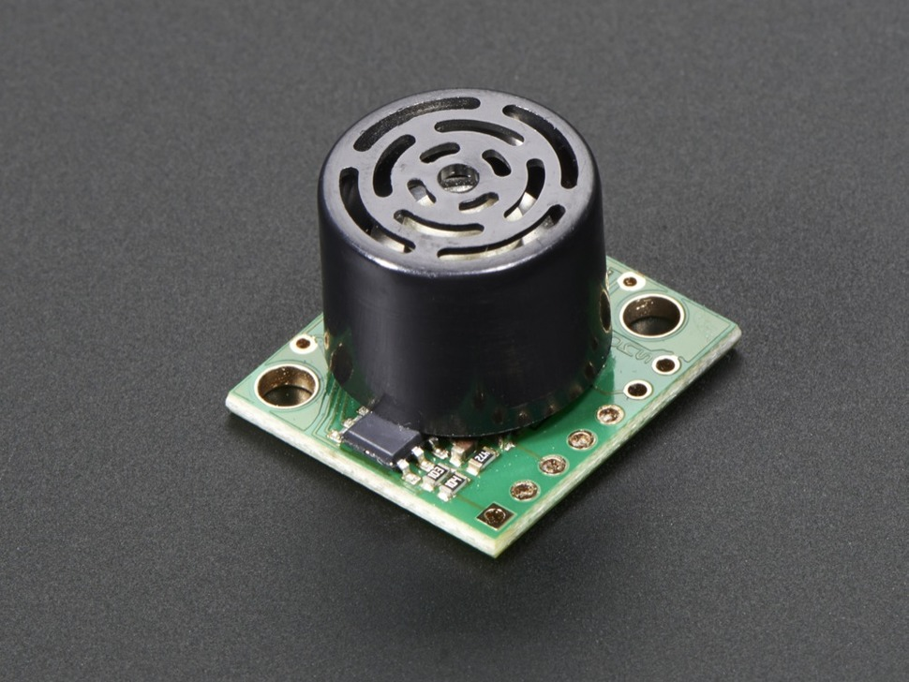
Detect Rear Incoming Objects
Solution: Ultrasonic Sensor
Maxbotix: LV-MaxSonar-EZ0
Range: 0 – 255 in. (~6m)
Analog Output: 10mV/inch
Notes:
The first problem is, how do I detect an approaching car?
Here I choose to use this ultrasonic sensor. It can detect objects up to 6 meters away.
The microcontroller reads the sensor’s analog signal. The distance detected will be reflected on the analog output of the sensor. Depending on the analog voltage level, the controller will know how far away the object is.
The controller then warns the biker about the object by beeping and flashing red leds. and I will cover those later.
The picture here is the area that this sensor will cover. A is for detection of smallest object and C is the larger object.

Slide 4

Automatic Lighting System
Solution: Triple Axis Accelerometer
Analog Devices: ADXL335
Sensing Range: +/- 3g
Method: Movement detection
Left or right acceleration = headlight on
Forward acceleration = headlight on
Backward acceleration = taillight on
Notes:
The next feature I want is automatic lighting system. A truly smart system that will work on its own.
The first problem I want to solve is how to detect bike’s movement? I choose an accelerometer here and it will allow me to know exactly what kind of force the bike is experiencing. It has a broad range of sensing between + - 3 g.
The micro-controller will read the X and Y analog outputs. From the analog outputs numbers, the microcontroller can enable headlight or taillight according to my settings.
The most interesting part of this is to find the optimum threshold value for each output. I have to determine how much g force it needs to experience so the system know the bike is moving. A threshold that is too small will be too sensitive and a number too big the light will never light up.
Here is animation.

Slide 5
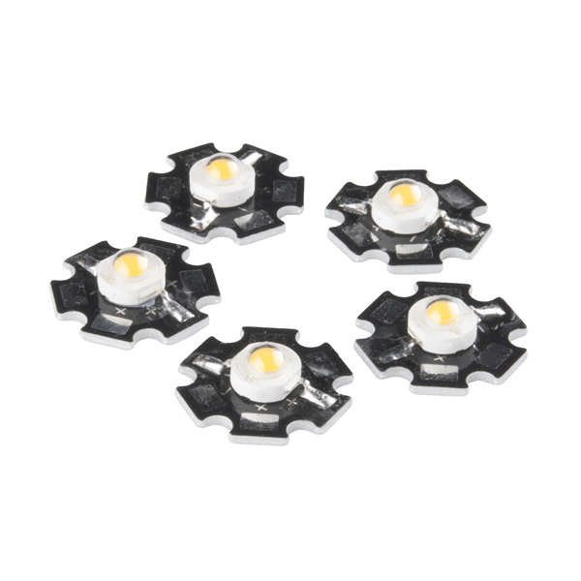
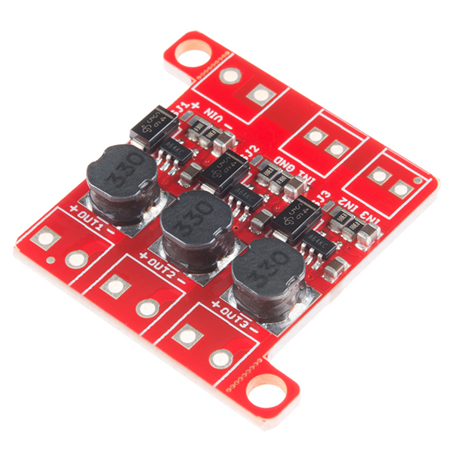
Automatic Lighting System
Solution: SMD LEDs
iPixel : 3W LEDs
Luminous Intensity: 160-200LM
Forward Current: 750mA
PicoBuck LED Driver
Drive Current: 330mA to 660mA
Method: Use Driver to provide current
When headlight is enabled, the driver will provide max current to enable each SMD LED
Notes:
Then, I will need to find a source of light. I choose to use SMD LEDs and they are really bright.
The microcontroller will not provide enough current to drive them like regular LEDs. So I use this PicoBuck LEDs driver as they can provide larger current.

Slide 6
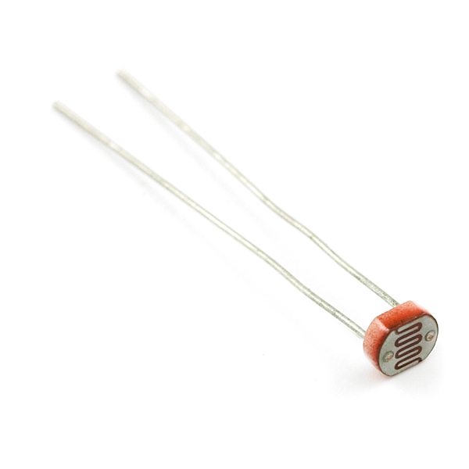
Automatic Lighting System
Solution: Photocell
SEN-09088
Light Resistance: ~1k ohm
Dark Resistance: ~10k ohm
Function: Nighttime detection
During night, the system will know it can turn on headlight and taillight
During day, it will disable both headlight and taillight.
Notes:
I want my product to be able to tell nighttime, so I used photocell as my light sensor.
It works like a variable resistor - when it is dark outside, it becomes strong resistor, when it is bright, it becomes a weak resistor.
When nighttime is detected, the system know that headlight and taillight are free to use.
If it is daytime, it will force the headlight or taillight to be off.

Slide 7
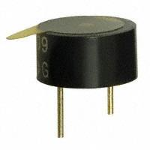
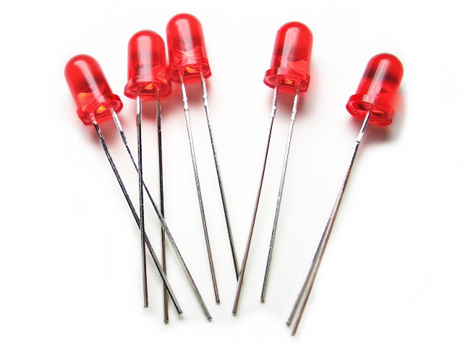
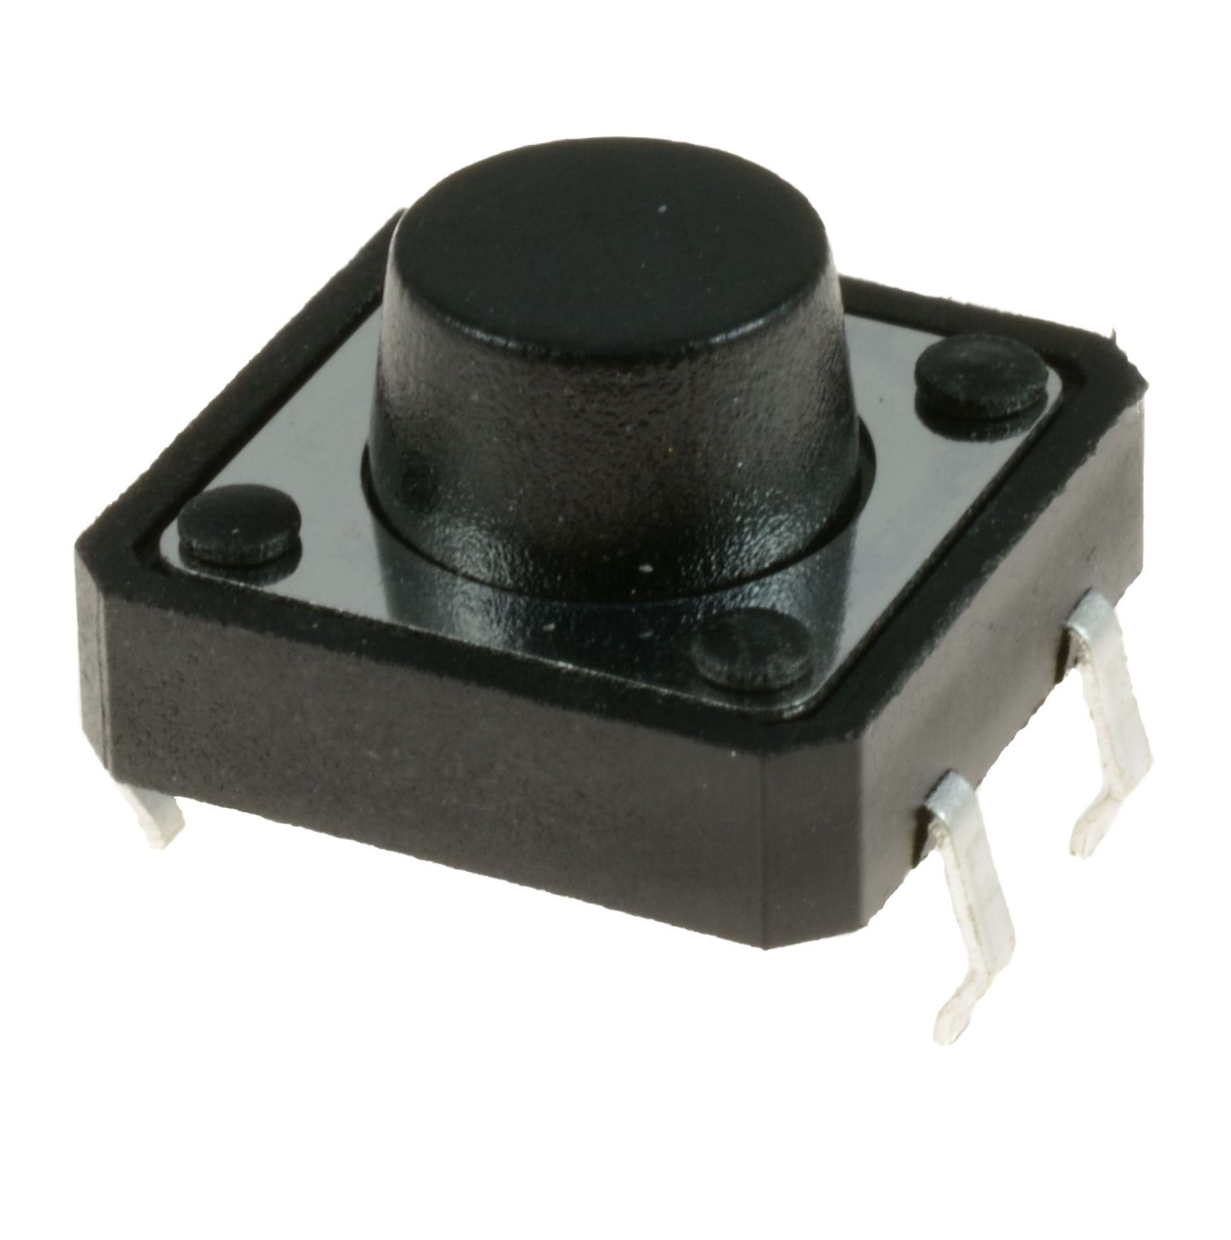
Rider Warning System
Solution: Buzzer, LEDs, push buttons
Buzzer Frequency: 2.73kHz
Sound Pressure: 80dB
The rate of the beeping from buzzer increases when approaching car gets closer
Red LEDs flash to warn biker when a car is approaching
Two buttons to enable LEDs at each side of the taillight to show turning signal.
Notes:
The smart system will need a way to warn the biker of incoming object and also let the biker warn other driver with turn signals.
To solve this problem, I installed buzzer, leds and push button.
The buzzer will be enable when my ultrasonic sensor detects an object. It will beep and its frequency changes depending on how close the object is.
The buzzer will make alarming noise when current is flowing between its pins.
It produces 80 decibel of noise and it can be pretty loud and noisy. As I was testing this buzzer, other teams in the lab kind of got annoyed, good thing this did not take me too long.
The push buttons are turn signal for the biker, when they are depressed, micro controller will blink the turn signal three times.
Push buttons is a pair of unconnected wire and when the button is pressed, the wire will be connected. I installed a grounded resistor between the wires, I was able to detect voltage changes when button is pressed.

